Slide 1

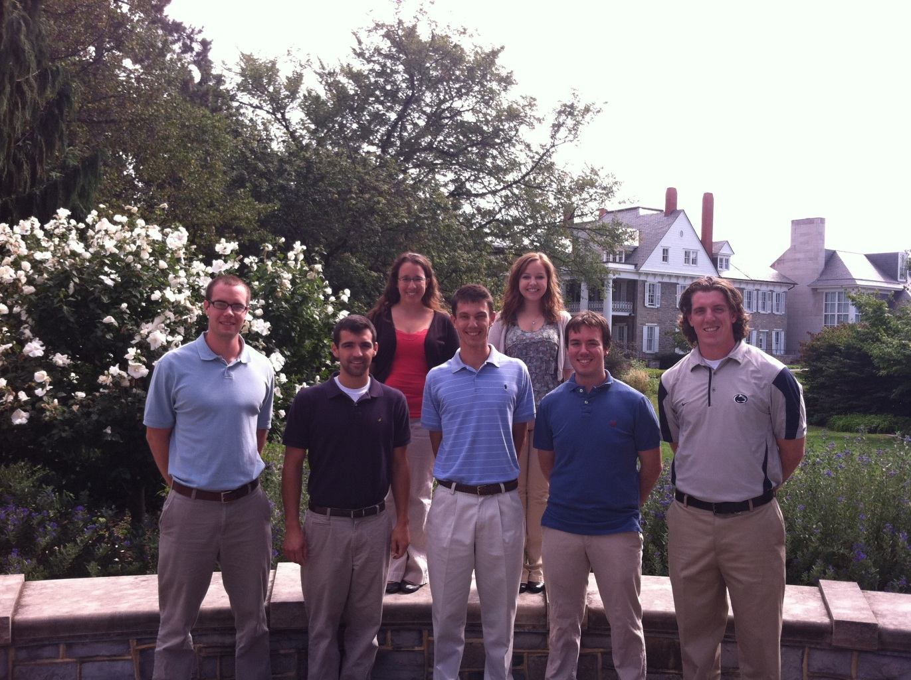

BIM Thesis Presentation
10 April 2013
http://content.asce.org/studentcompetition/index.html
Brian LaChance | Mike Palmer | Rachel Barrow
Alex Byard | Melanie Fonner
Brad Frederick | Pat Allen

Slide 2

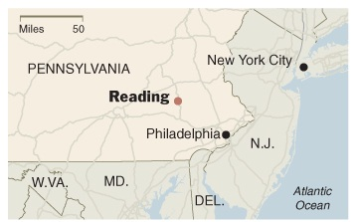


Reading School District
https://www.google.com/imghp?hl=en&tab=wi
https://www.google.com/imghp?hl=en&tab=wi
Project Background Goals Site Plan Building Analysis Conclusion Appendix

Slide 3






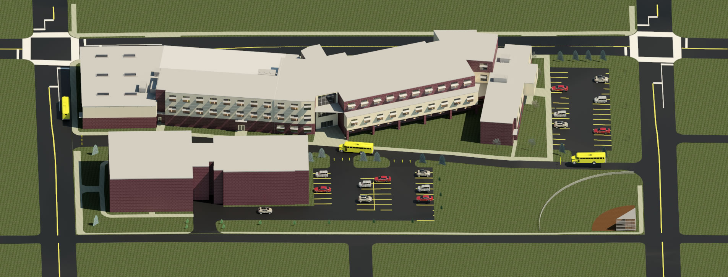




Goals
Owner Core Values
Nexus Goals
Safety & Security
Integration
Lifecycle & Maintenance
Reduce, Reuse, Recover
Cost Effective
Learning Tool
Project Background Goals Site Plan Building Analysis Conclusion Appendix

Slide 4
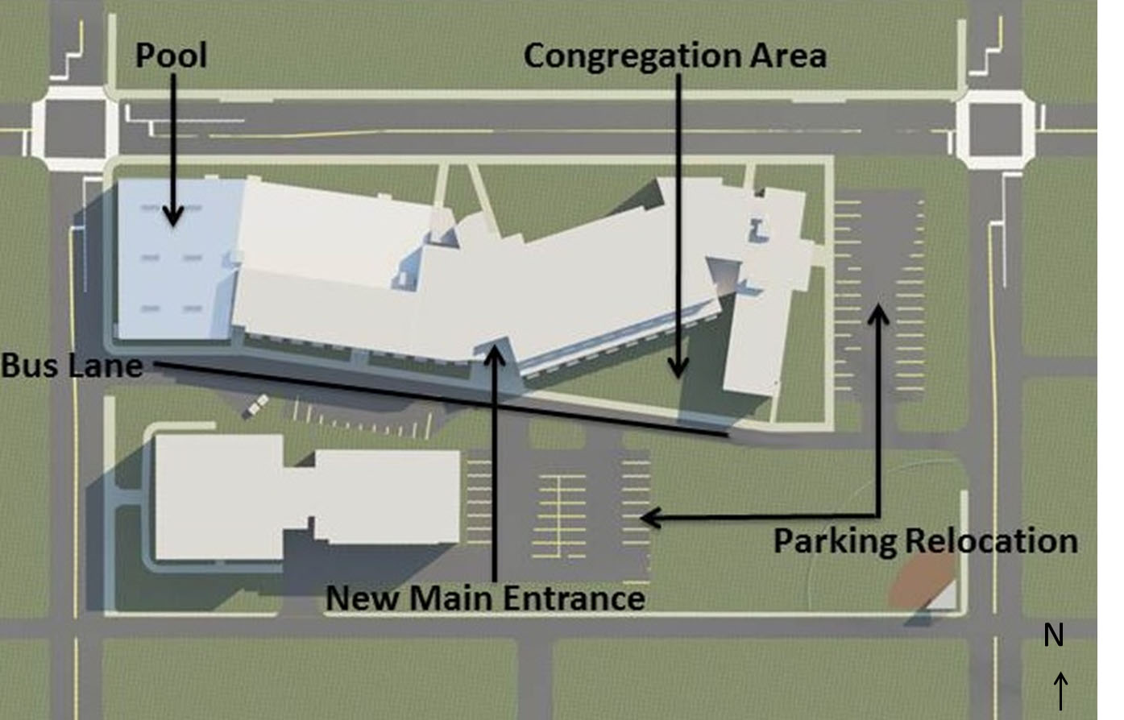
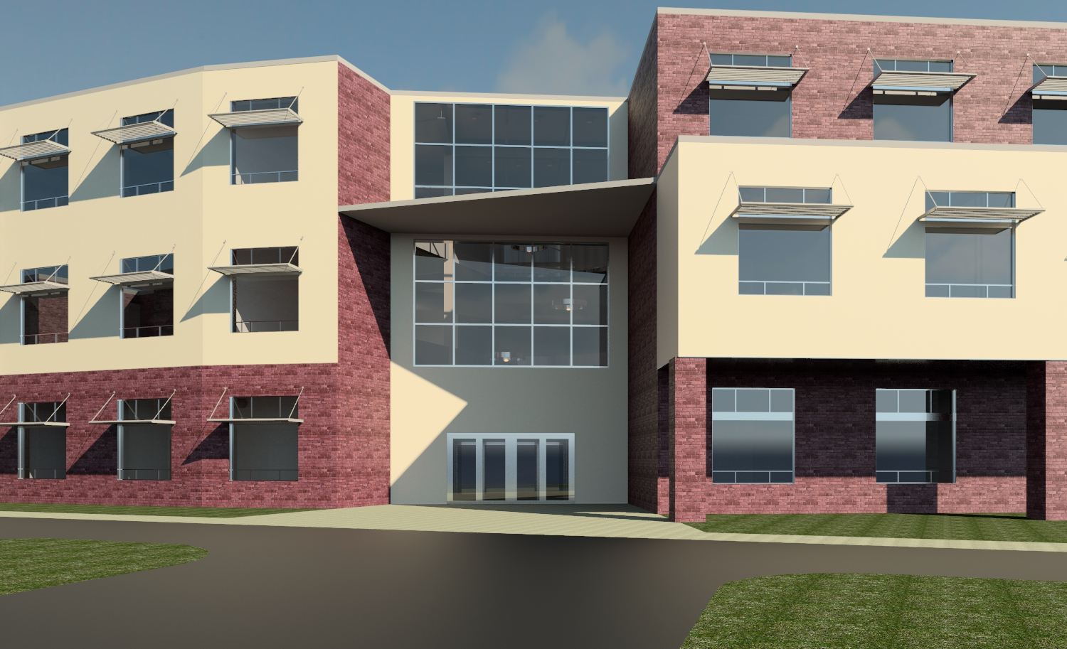
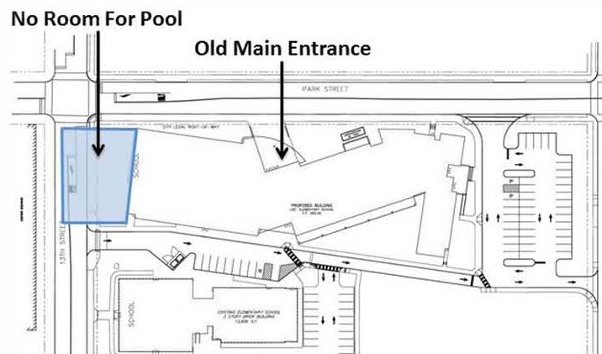
Site Plan
N
N
Original Site Plan
New Site Plan
Project Background Goals Site Plan Building Analysis Conclusion Appendix

Slide 5
Lobby Community Education
Project Background Goals Site Plan Building Analysis Conclusion Appendix

Slide 6
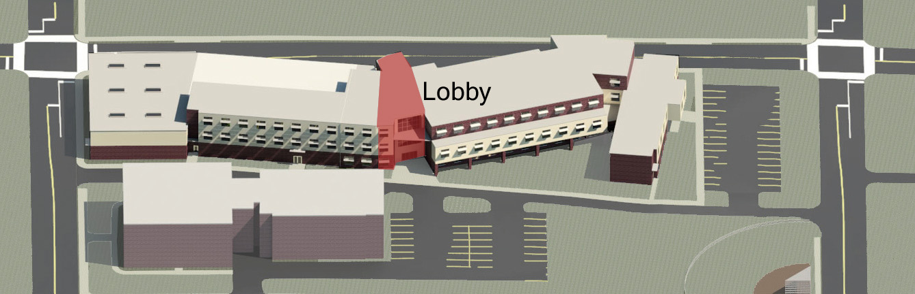
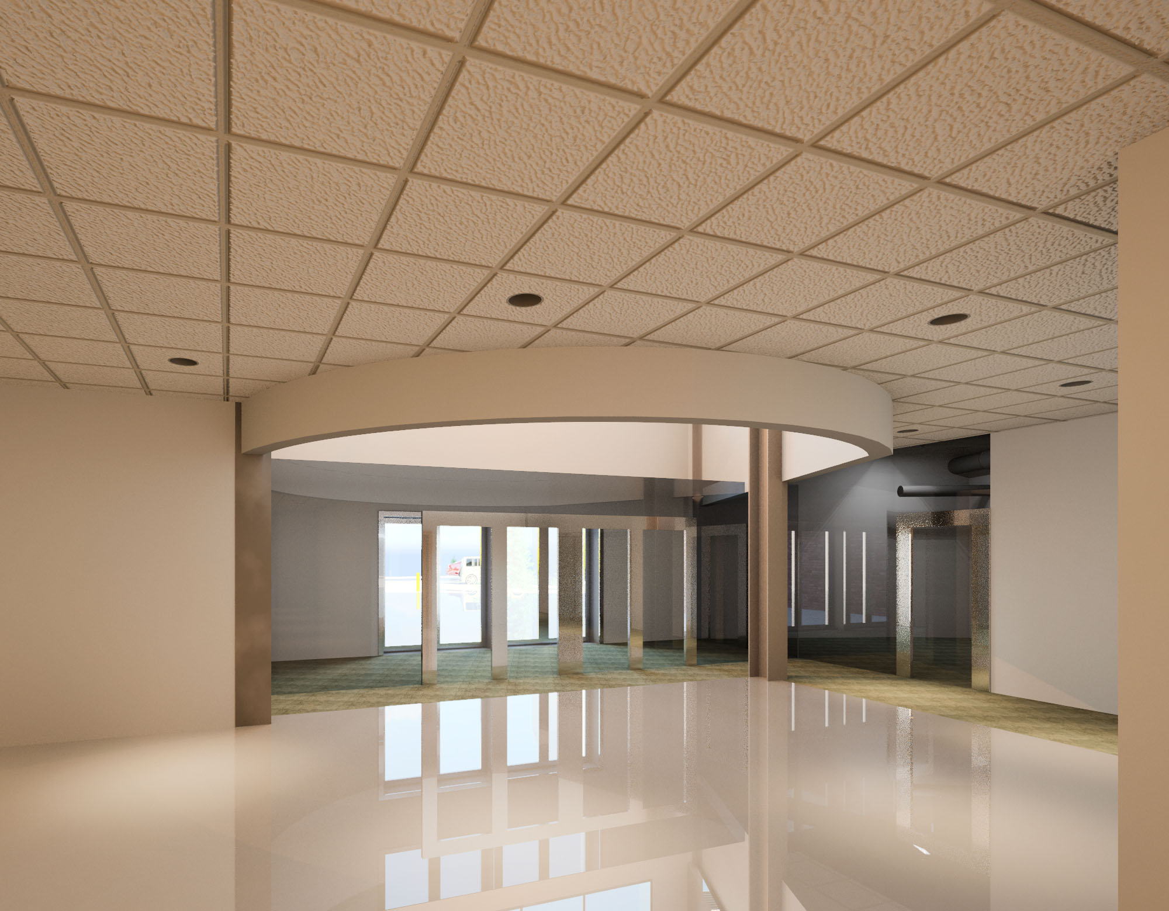
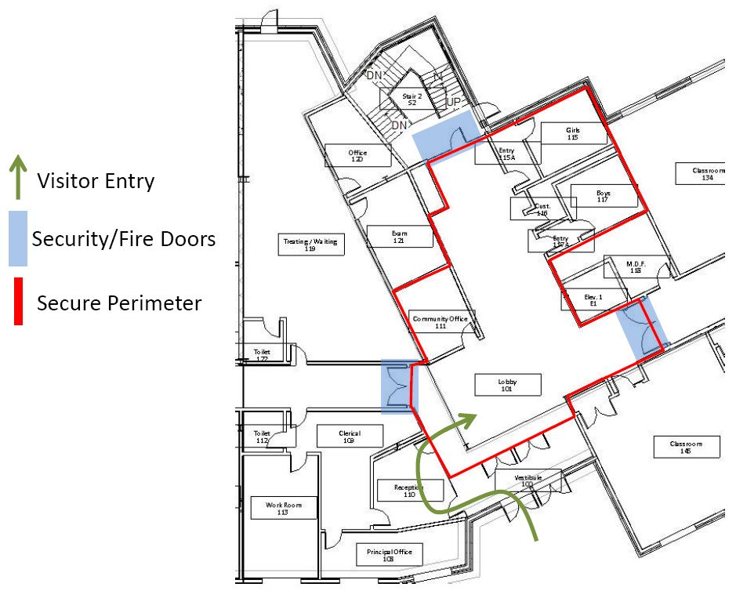
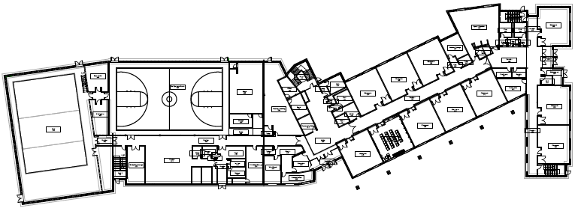
Lobby
N
N
Project Background Goals Site Plan Building Analysis Conclusion Appendix

Slide 7
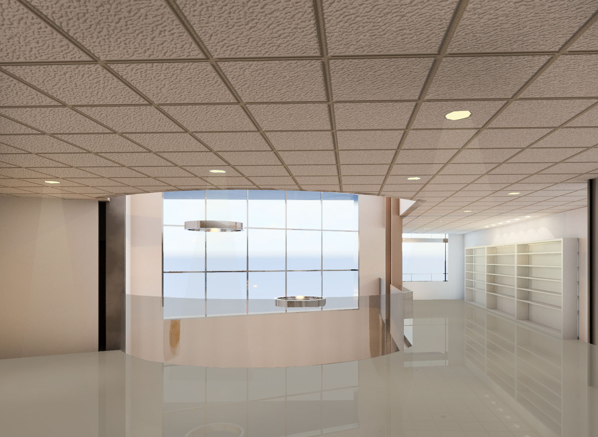
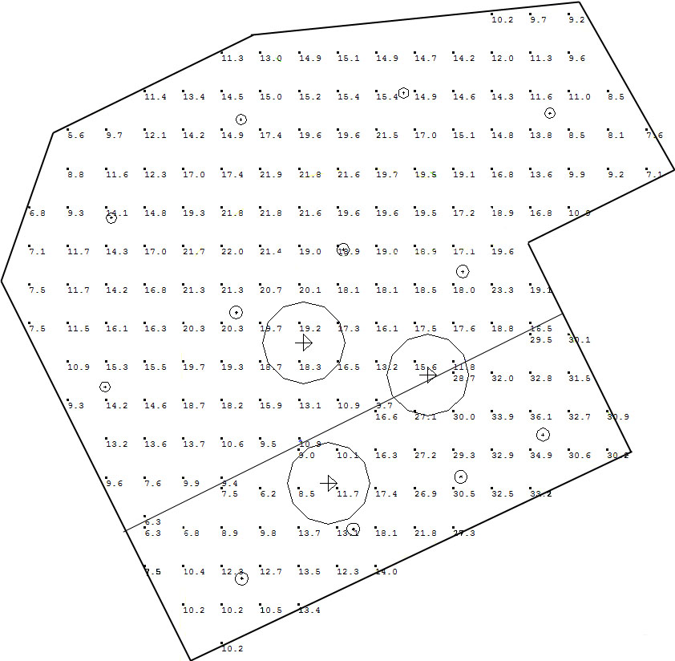
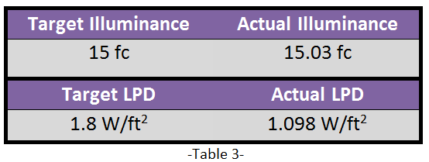
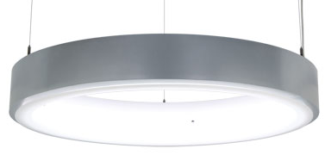
Lobby
N
N
150 W CMH
Decorative Pendant
32W CFL Downlight
Project Background Goals Site Plan Building Analysis Conclusion Appendix

Slide 8
Lobby Community Education
Project Background Goals Site Plan Building Analysis Conclusion Appendix

Slide 9
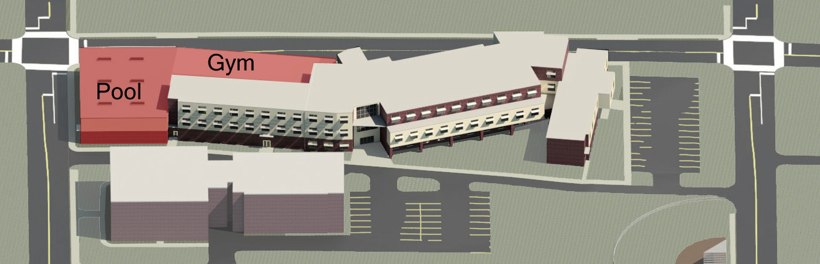
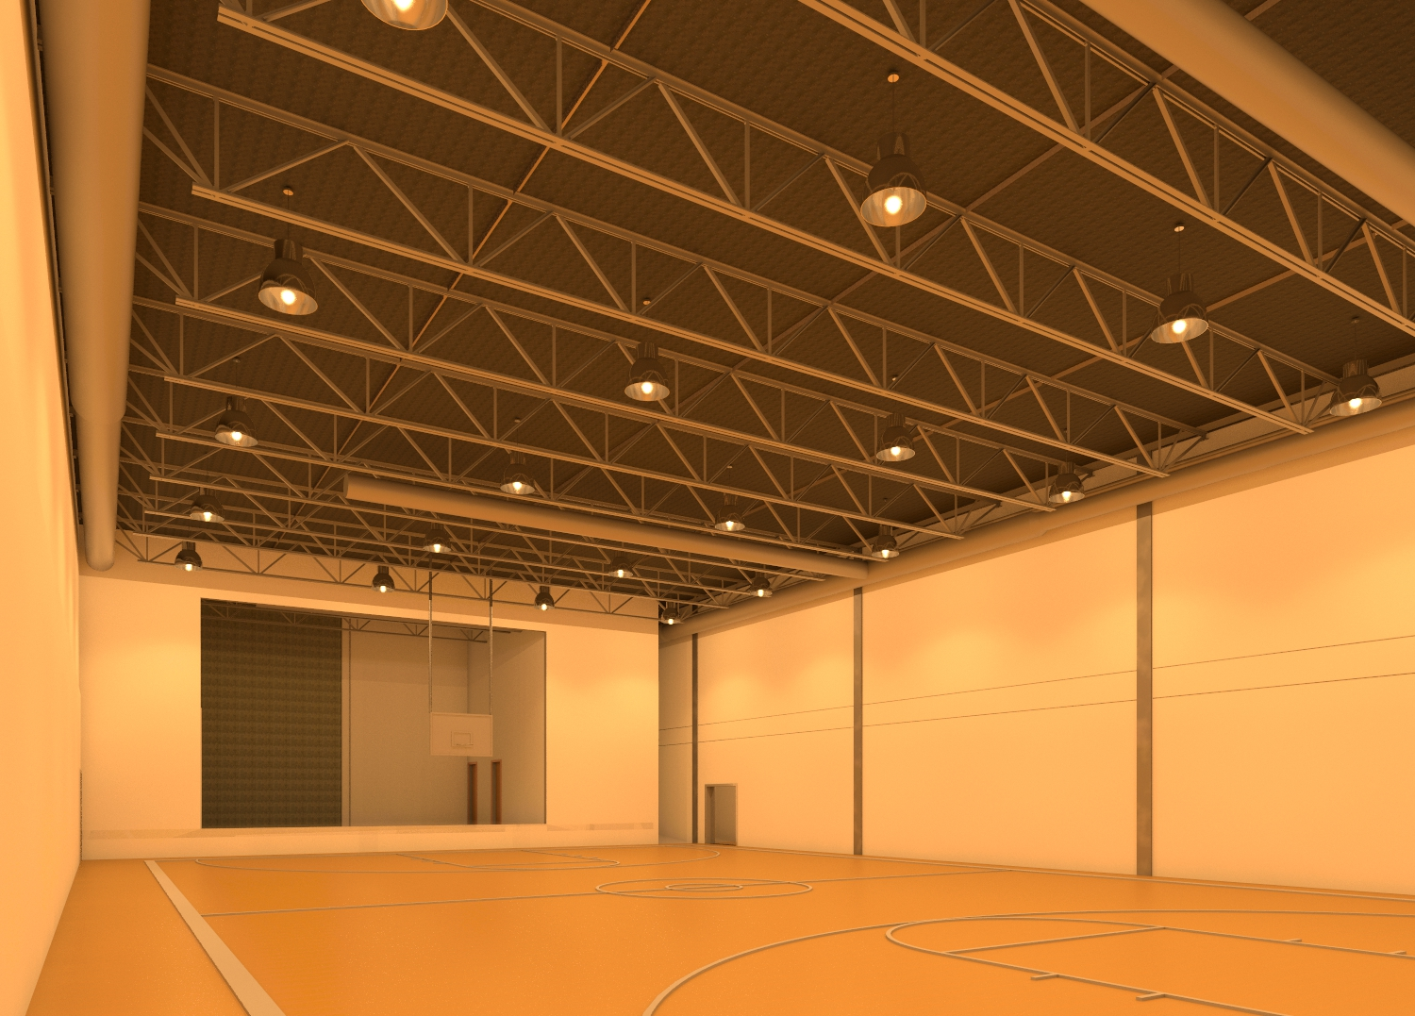
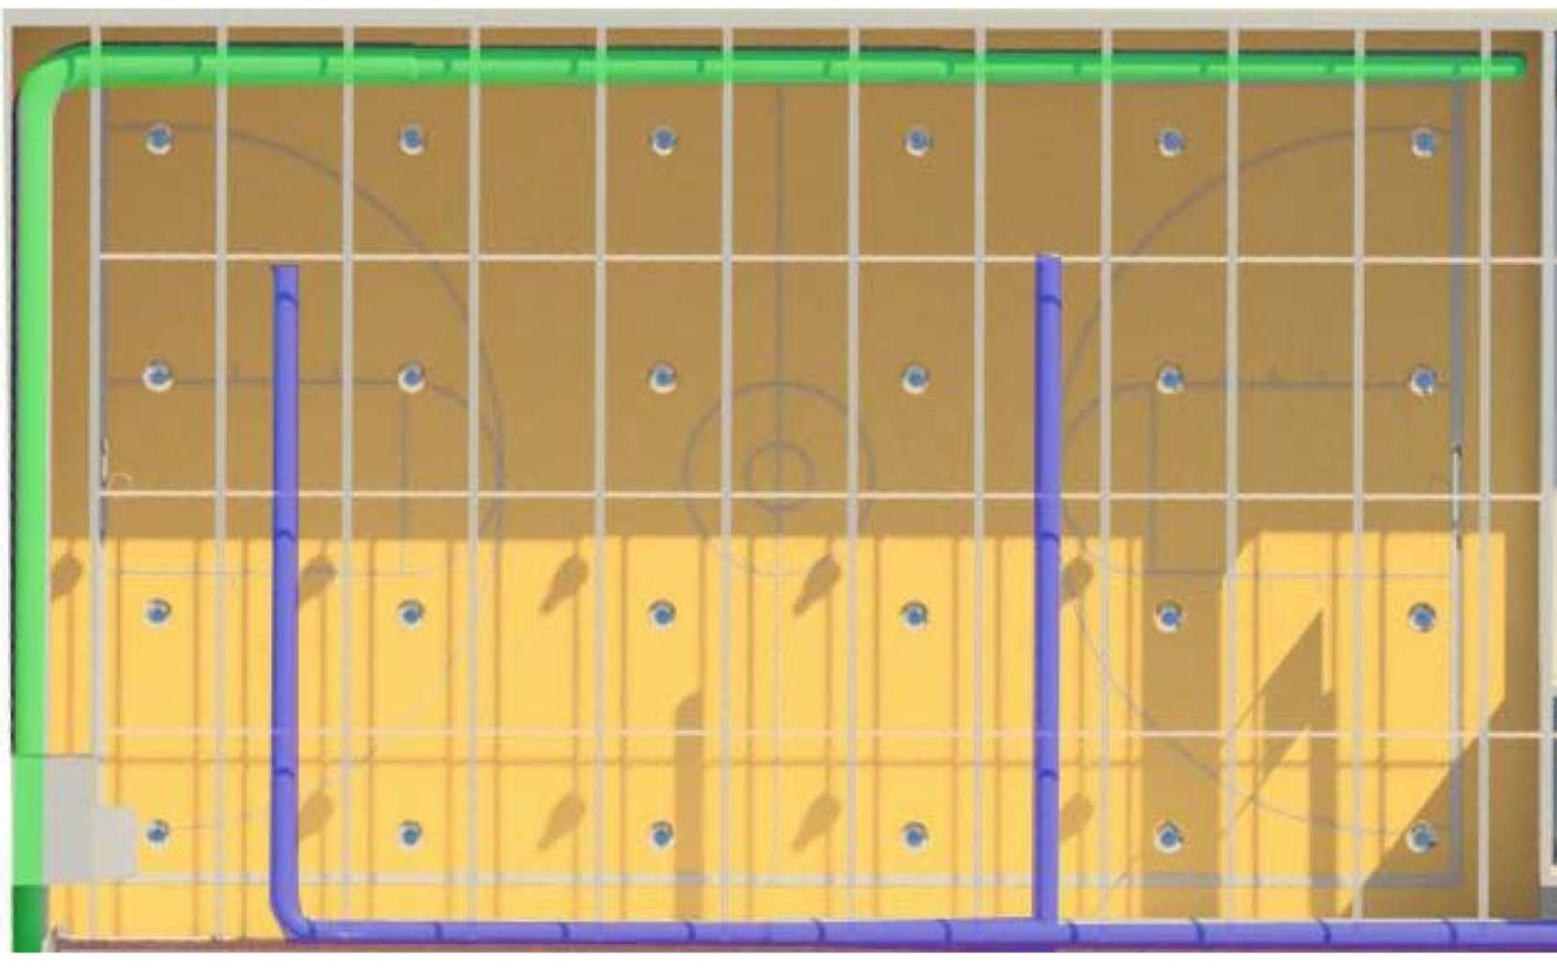
Multipurpose Room
N
Project Background Goals Site Plan Building Analysis Conclusion Appendix

Slide 10
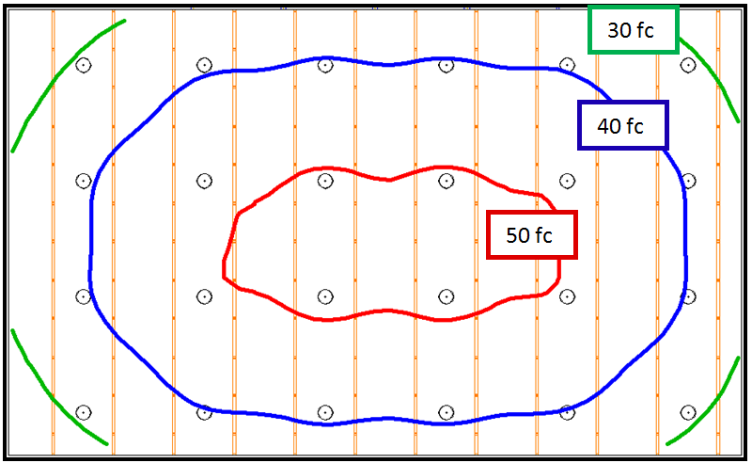
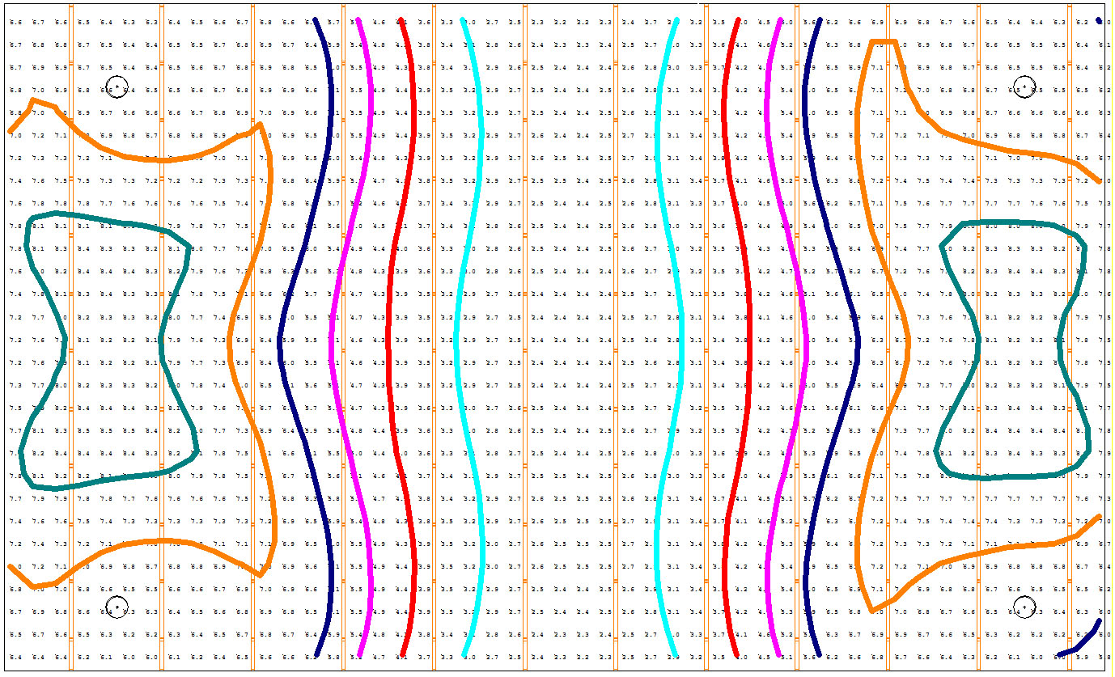
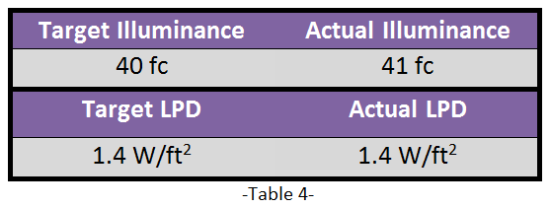
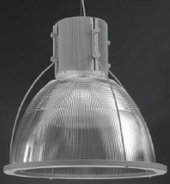
Multipurpose Room
6 fc
3 fc
7 fc
4 fc
8 fc
5 fc
N
Project Background Goals Site Plan Building Analysis Conclusion Appendix

Slide 11
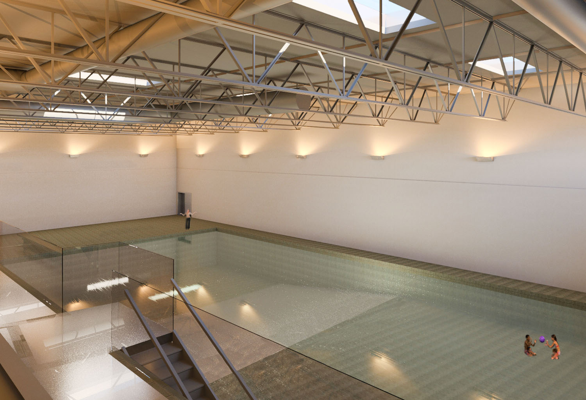
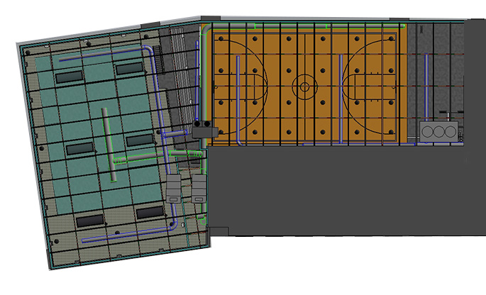
Pool
N
Project Background Goals Site Plan Building Analysis Conclusion Appendix

Slide 12
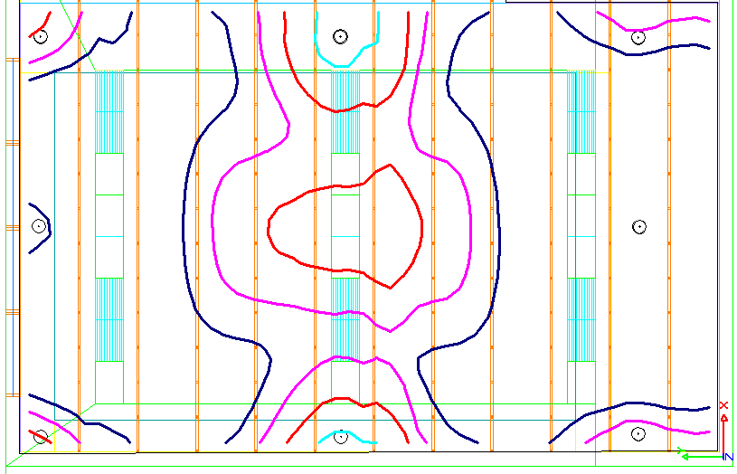
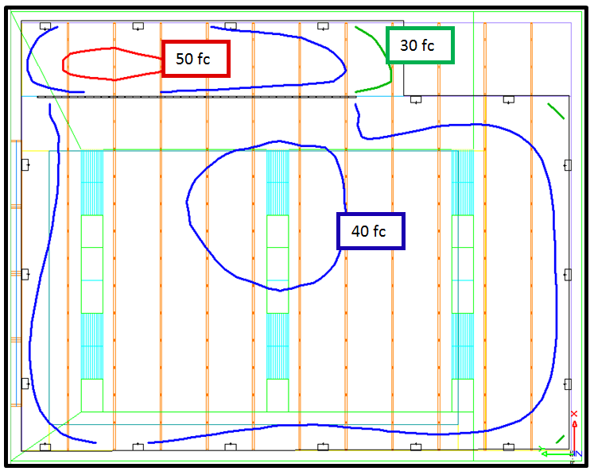
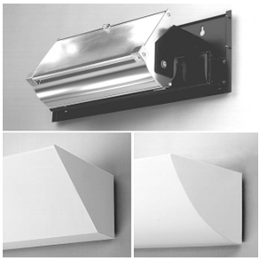
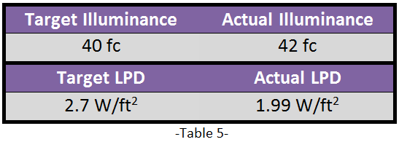
Pool
7 fc
8 fc
9 fc
10 fc
N
N
Project Background Goals Site Plan Building Analysis Conclusion Appendix

Slide 13
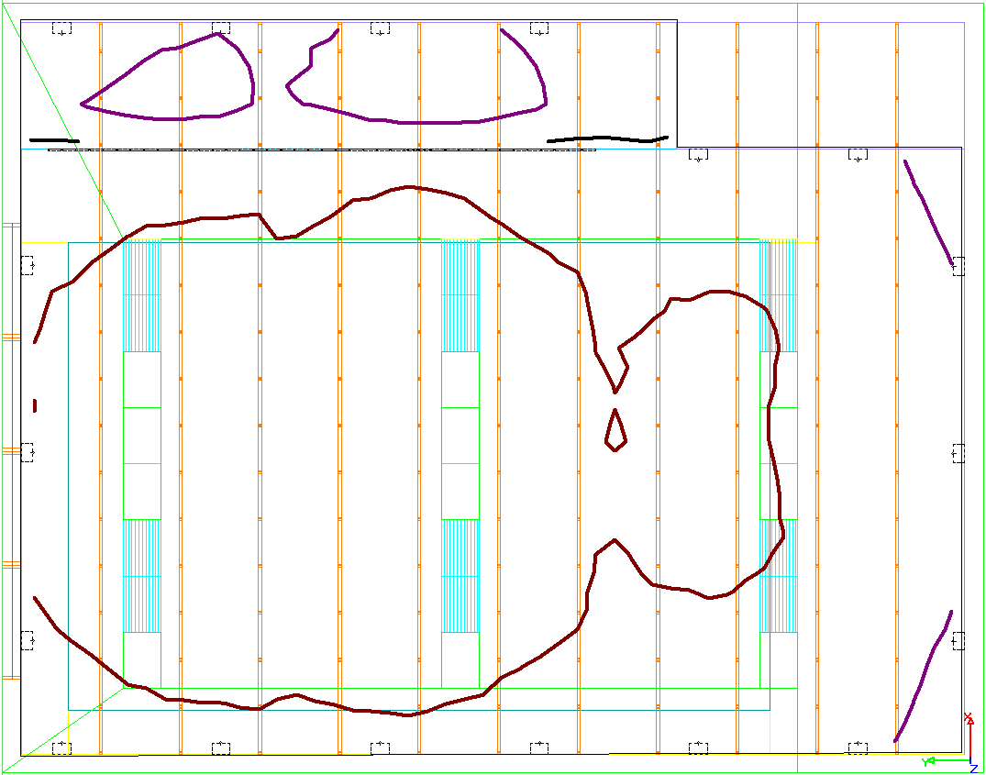
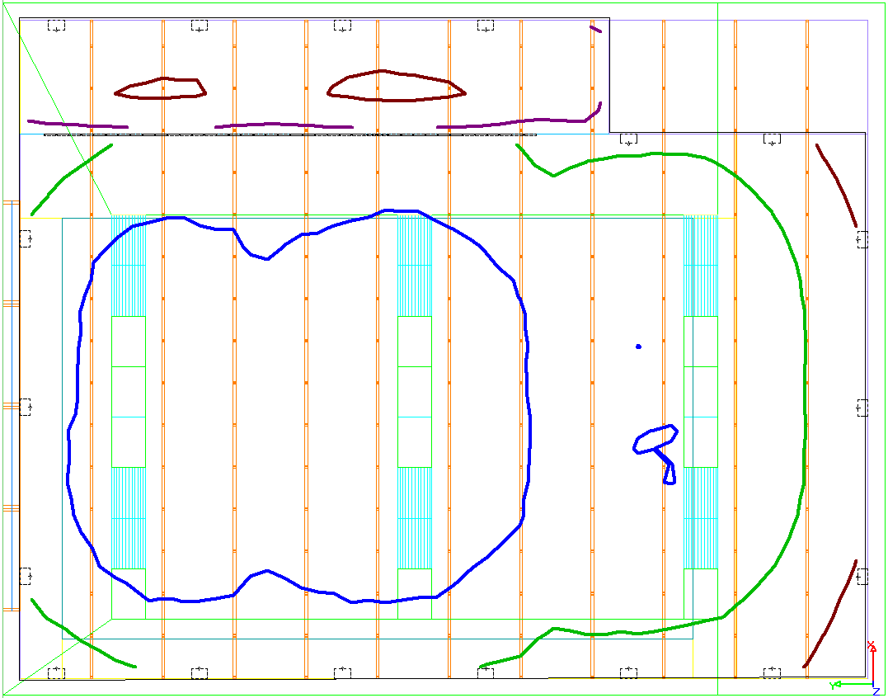
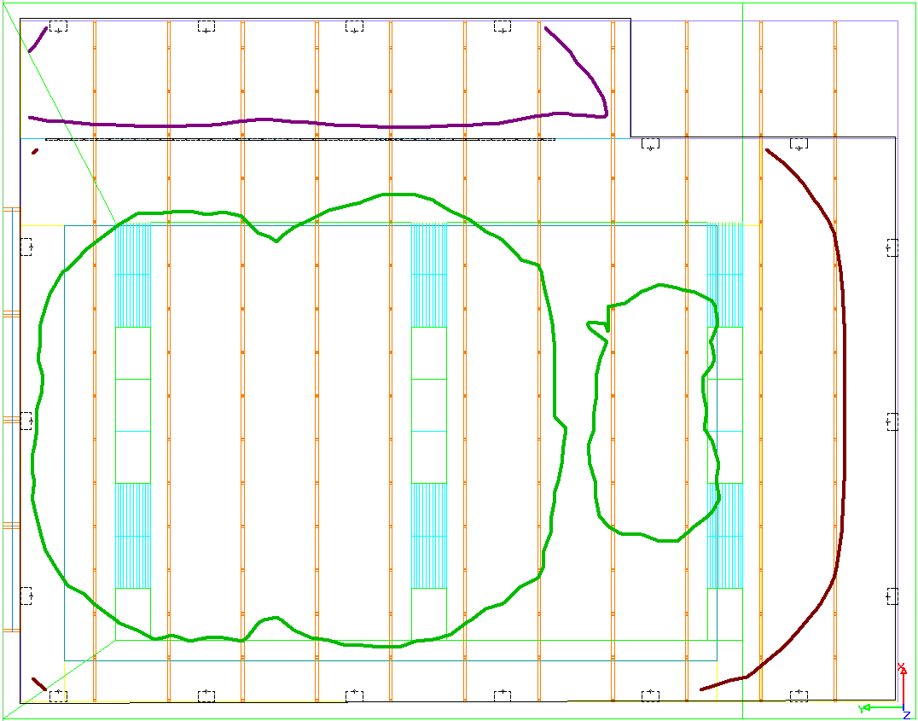
Pool - Daylighting
Daylight Only
40 fc
10 fc
10 fc
20 fc
30 fc
30 fc
N
20 fc
10 fc
20 fc
Winter Solstice – Clear Sky, Noon
Summer Solstice – Clear Sky, Noon
Spring/Fall Equinox – Clear Sky, Noon
Project Background Goals Site Plan Building Analysis Conclusion Appendix

Slide 14
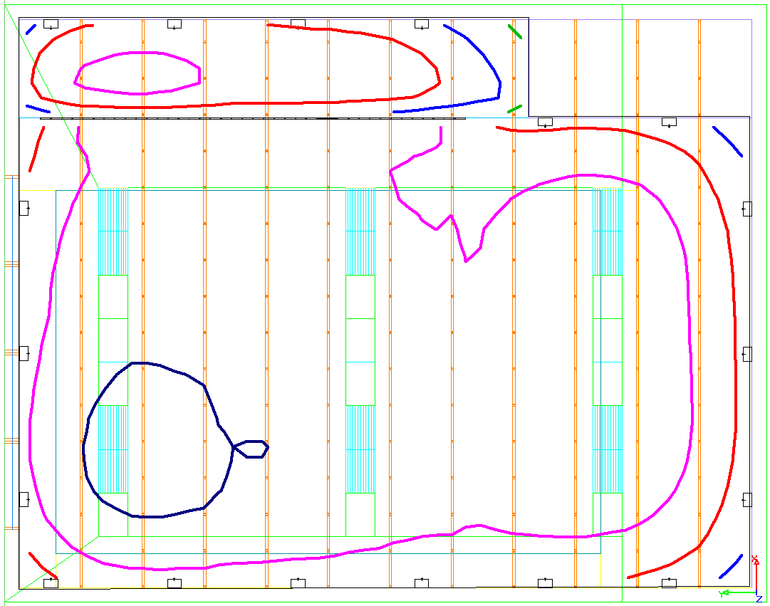
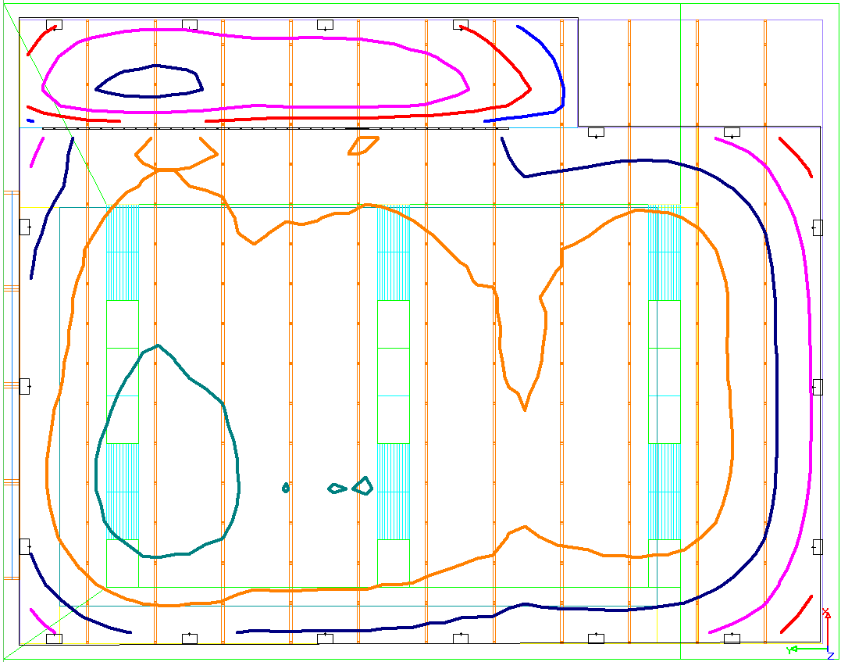
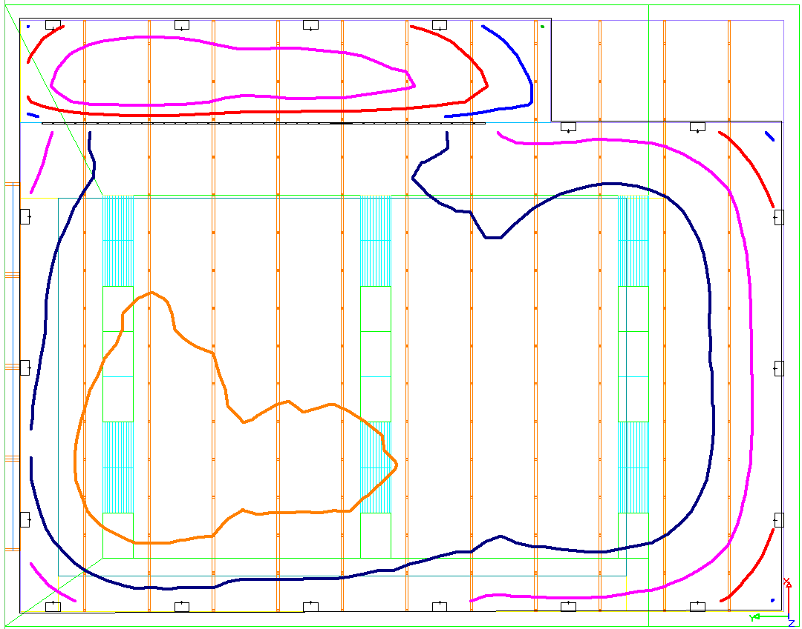
Pool - Daylighting
Daylight & Electric
70 fc
90 fc
80 fc
60 fc
70 fc
80 fc
60 fc
50 fc
70 fc
60 fc
50 fc
N
40 fc
40 fc
Winter Solstice – Clear Sky, Noon
Summer Solstice – Clear Sky, Noon
Spring/Fall Equinox – Clear Sky, Noon
Project Background Goals Site Plan Building Analysis Conclusion Appendix

Slide 15
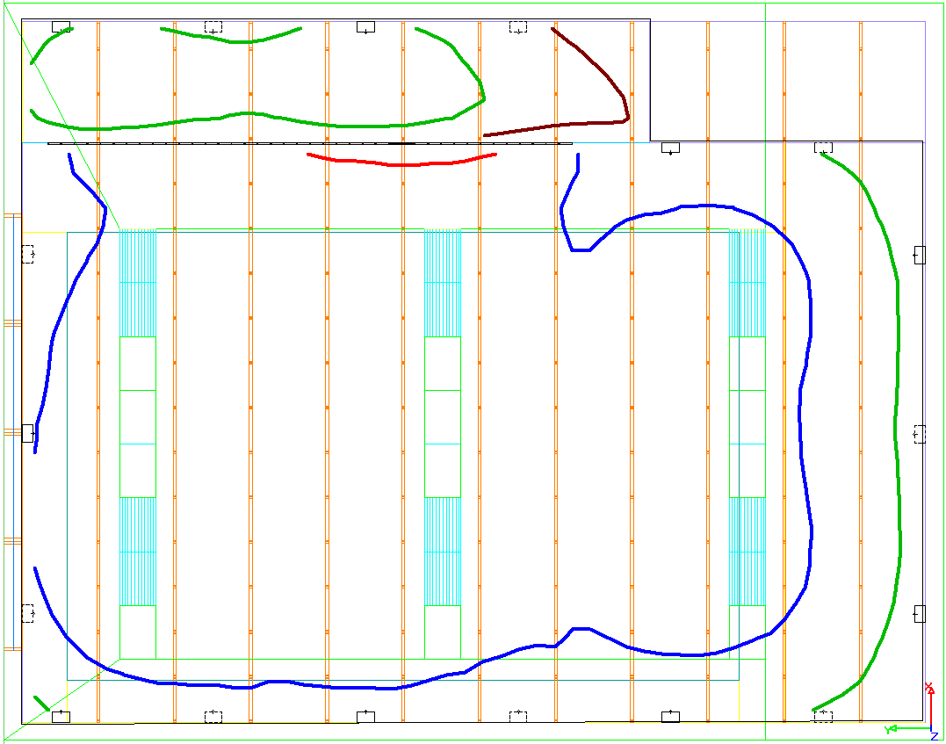
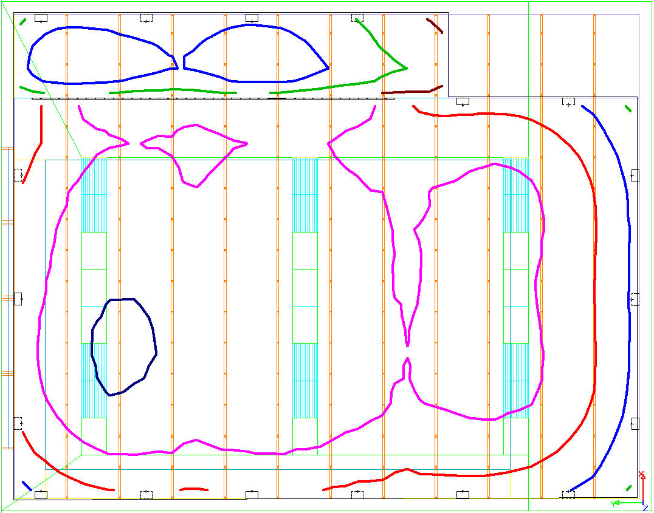
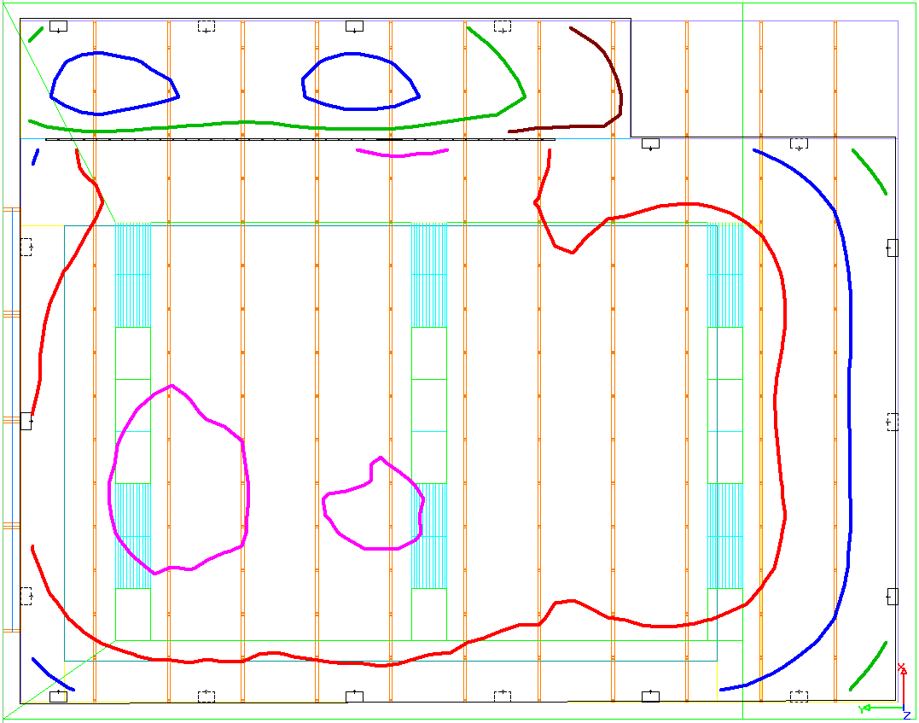
Pool - Daylighting
Daylight & Electric at ½ output
70 fc
60 fc
20 fc
60 fc
50 fc
40 fc
50 fc
40 fc
30 fc
N
40 fc
Winter Solstice – Clear Sky, Noon
Summer Solstice – Clear Sky, Noon
Spring/Fall Equinox – Clear Sky, Noon
Project Background Goals Site Plan Building Analysis Conclusion Appendix

Slide 16
Lobby Community Education
Project Background Goals Site Plan Building Analysis Conclusion Appendix

Slide 17
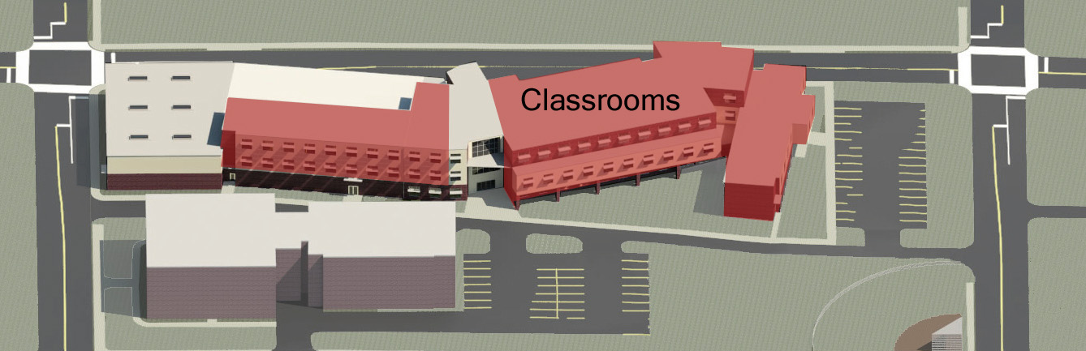
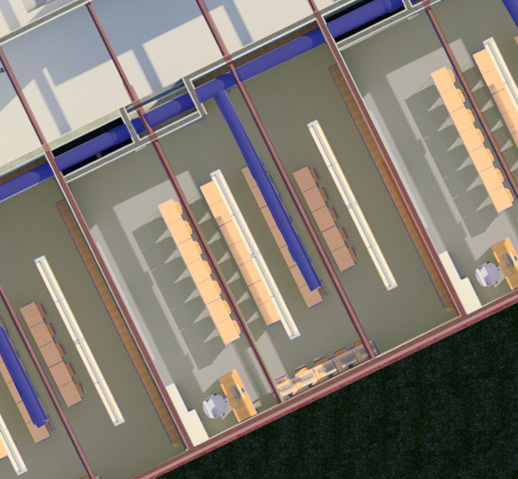
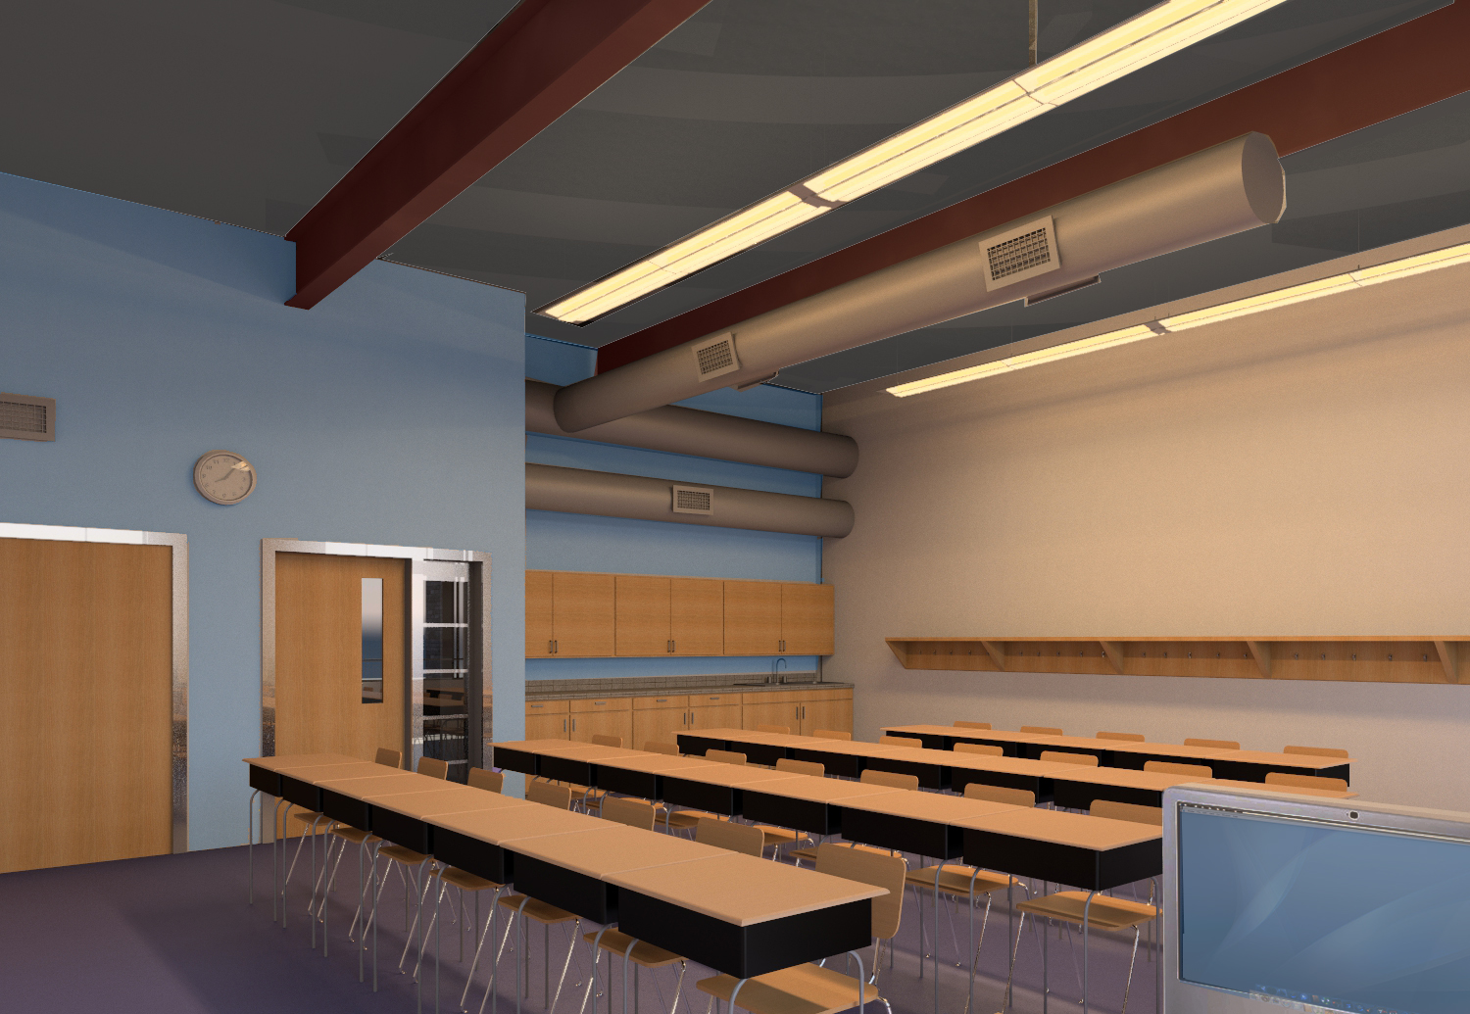
Classroom
N
Project Background Goals Site Plan Building Analysis Conclusion Appendix

Slide 18
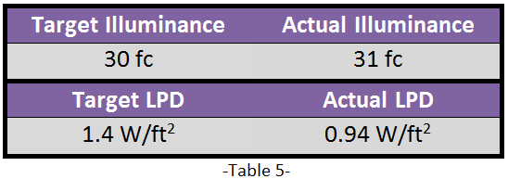
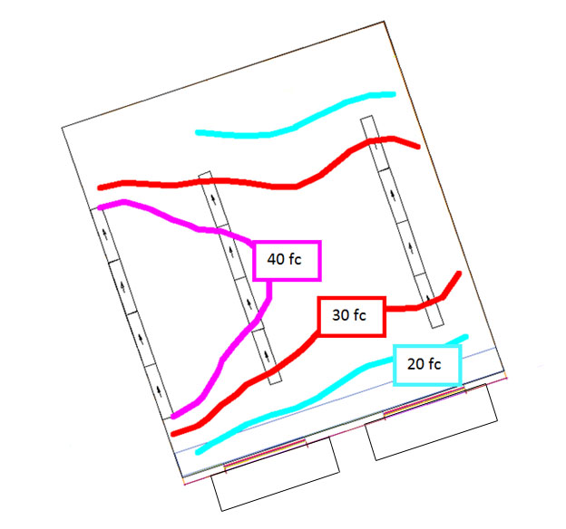
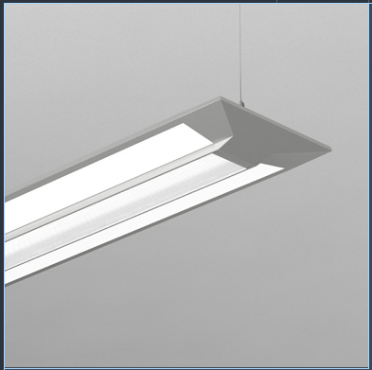
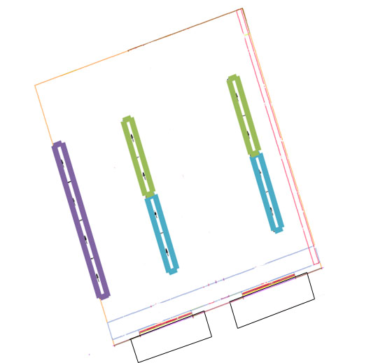
Classroom
Zone 1
Zone 2
Zone 3
N
Project Background Goals Site Plan Building Analysis Conclusion Appendix

Slide 19
Conclusion
Owner Core Values
Nexus Goals
Safety & Security
Integration
Lifecycle & Maintenance
Reduce, Reuse, Recover
Cost Effective
Learning Tool
Project Background Goals Site Plan Building Analysis Conclusion Appendix

Slide 20
Conclusion
THANKS!
Mom and Dad!
Nexus Team Members
Friends
AE Staff and Faculty
AEI Judges
Project Background Goals Site Plan Building Analysis Conclusion Appendix

Slide 21
Conclusion
Questions?
Project Background Goals Site Plan Building Analysis Conclusion Appendix

Slide 22
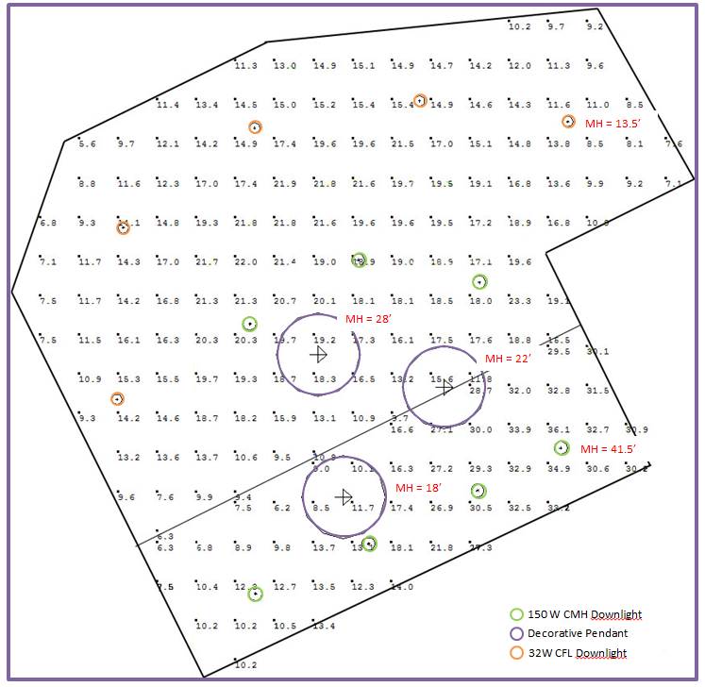
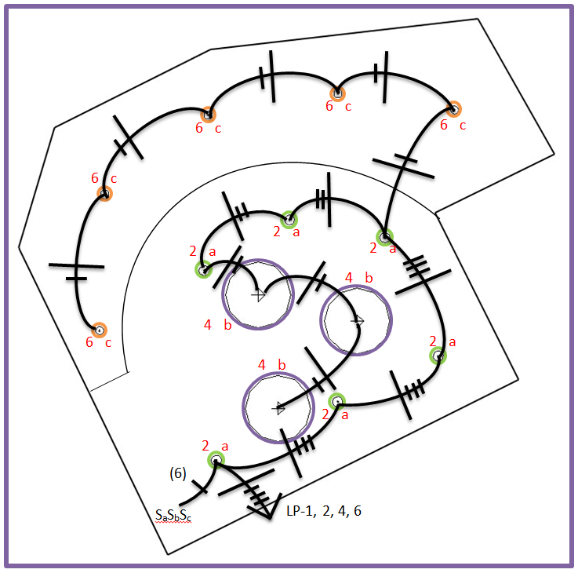
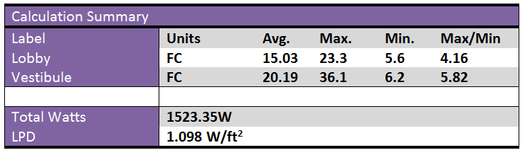
Appendix – Lobby
Project Background Goals Site Plan Building Analysis Conclusion Appendix

Slide 23
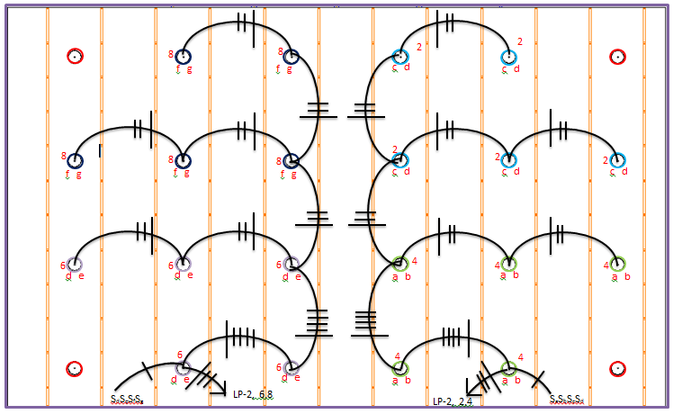
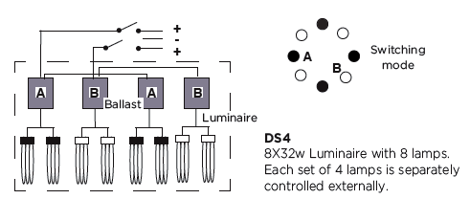
Appendix – Multipurpose Room
Zone 1
Zone 2
Zone 3
Zone 4
Emergency
Source: LUMINIS PRISMA NOVA 22
Project Background Goals Site Plan Building Analysis Conclusion Appendix

Slide 24
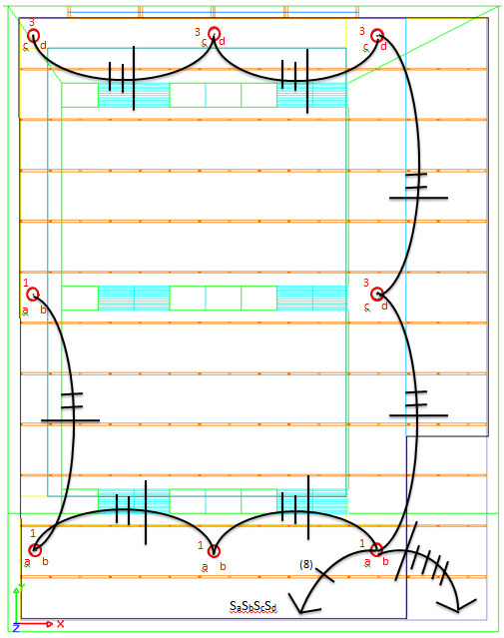
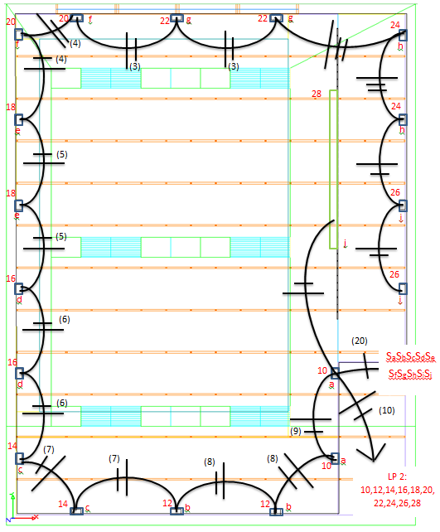
Appendix – Pool
Project Background Goals Site Plan Building Analysis Conclusion Appendix

Slide 25






Appendix – Classroom (Clear Sky)
Noon
NO SHADES
NO SHADES
NO SHADES
Winter: Maximum – 1823 fc Average – 287.49 fc
Spring/Fall: Maximum – 191 fc Average – 49.92 fc
Summer: Maximum – 135 fc Average – 38.29 fc
WITH SHADES
WITH SHADES
WITH SHADES
Winter: Maximum – 1661 fc Average – 65.05 fc
Spring/Fall: Maximum – 60.2 fc Average – 19.04 fc
Summer: Maximum – 30.5 fc Average – 12.88 fc
Project Background Goals Site Plan Building Analysis Conclusion Appendix

Slide 26






Appendix – Classroom (Cloudy Sky)
Noon
NO SHADES
NO SHADES
NO SHADES
Winter: Maximum – 43.7 fc Average – 9.10 fc
Spring/Fall: Maximum – 73.9 fc Average – 15.38 fc
Summer: Maximum – 93 fc Average – 19.36 fc
WITH SHADES
WITH SHADES
WITH SHADES
Winter: Maximum – 6.1 fc Average – 2.54 fc
Spring/Fall: Maximum – 10.4 fc Average – 4.30 fc
Summer: Maximum – 13.1 fc Average – 5.41 fc
Project Background Goals Site Plan Building Analysis Conclusion Appendix

Slide 27






Appendix – Classroom (Clear Sky)
9 AM
NO SHADES
NO SHADES
NO SHADES
Winter: Maximum – 805 fc Average – 201 fc
Spring/Fall: Maximum – 2096 fc Average – 138.4 fc
Summer: Maximum – 124 fc Average – 38.48 fc
WITH SHADES
WITH SHADES
WITH SHADES
Winter: Maximum – 714 fc Average – 30.82 fc
Spring/Fall: Maximum – 86.9 fc Average – 27.29 fc
Summer: Maximum – 29.2 fc Average – 13.53 fc
Project Background Goals Site Plan Building Analysis Conclusion Appendix

Slide 28






Appendix – Classroom (Cloudy Sky)
9 AM
NO SHADES
NO SHADES
NO SHADES
Winter: Maximum – 23.8 fc Average – 4.95 fc
Spring/Fall: Maximum – 50 fc Average – 10.41 fc
Summer: Maximum – 72.3 fc Average – 15.06 fc
WITH SHADES
WITH SHADES
WITH SHADES
Winter: Maximum – 3.3 fc Average – 1.38 fc
Spring/Fall: Maximum – 7 fc Average – 2.91 fc
Summer: Maximum – 10.2 fc Average – 4.21 fc
Project Background Goals Site Plan Building Analysis Conclusion Appendix

Slide 29






Appendix – Classroom (Clear Sky)
3 PM
NO SHADES
NO SHADES
NO SHADES
Winter: Maximum – 803 fc Average – 74.05 fc
Spring/Fall: Maximum – 108 fc Average – 31.94 fc
Summer: Maximum – 87.2 fc Average – 28.94 fc
WITH SHADES
WITH SHADES
WITH SHADES
Winter: Maximum – 43.4 fc Average – 13.16 fc
Spring/Fall: Maximum – 25.2 fc Average – 10.75 fc
Summer: Maximum – 23.4 fc Average – 10.03 fc
Project Background Goals Site Plan Building Analysis Conclusion Appendix

Slide 30






Appendix – Classroom (Cloudy Sky)
3 PM
NO SHADES
NO SHADES
NO SHADES
Winter: Maximum – 24.4 fc Average – 5.07 fc
Spring/Fall: Maximum – 55 fc Average – 11.45 fc
Summer: Maximum – 74.5 fc Average – 15.50 fc
WITH SHADES
WITH SHADES
WITH SHADES
Winter: Maximum – 3.4 fc Average – 1.42 fc
Spring/Fall: Maximum – 7.7 fc Average – 3.20 fc
Summer: Maximum – 10.5 fc Average – 4.33 fc
Project Background Goals Site Plan Building Analysis Conclusion Appendix

Slide 31

Appendix – Classroom
Project Background Goals Site Plan Building Analysis Conclusion Appendix

